Slide 1
Leveraging NLP for Enhanced Company Performance: Transformer-Based Sentiment Analysis and Comparative Review
MSc Data Science (2023/2024),Department of Mathematics and Computer Science, University of Greenwich
by
Dinuja R. Perera | 001273076
Supervisor: Dr. Konstantin Kapinchev

Slide 2

Problem
How can
the analysis of Company Reviews
be utilised to extract insights
beneficial for
companies?
Notes:
End users: Companies. Organisations that provides mL solutions to other organisations.

Slide 3

Goal
Analysing company reviews
across industries
to extract insights
regarding employee sentiments
and
company perceptions.
Notes:
IAn today's competitive business landscape, companies are constantly seeking ways to improve their products, services, and overall customer satisfaction. One way to achieve this is to leverage the power of data science, specifically focusing on natural language processing (NLP) techniques and machine learning.
Enhance company performance through sentiment analysis and comparative reviews using data science methodologies, focusing on Natural Language Processing (NLP) and machine learning techniques.
Leverage NLP and machine learning to analyze customer sentiments from 100,000 company reviews.
Train a pre-trained transformer-based model to predict sentiments (positive, negative, or neutral) using NLP techniques like tokenization, stemming, and feature extraction.
Apply topic modeling (LDA/NMF) to identify prevalent discussion topics and uncover customer preferences across companies.
Conduct a comparative analysis, calculating metrics (average rating, positive review percentage) and analyzing frequent topics, revealing company strengths and weaknesses.
Utilize aspect-based sentiment analysis (NER/POS tagging) to pinpoint specific aspects like customer service, product quality, and pricing for a granular understanding of customer satisfaction.
Aim to deliver actionable insights and recommendations to companies for product, service, and customer satisfaction improvements.

Slide 4
Project Objectives
Sentiment Analysis:
  - A pre-trained transformer-based model
  - Predict the sentiment (positive or negative) of a review based on its text.
Topic Modelling:
  - Identify the prevalent topics discussed in the reviews.
Comparative Analysis:
  - By aggregating and analysing the reviews for each company.
Aspect-Based Sentiment Analysis:
  - To identify specific aspects mentioned in the reviews and determine the sentiment of each aspect.
Generate an Interactive Dashboard for Visualization.
Notes:
This project aims to develop a comprehensive understanding of customer sentiments expressed in company reviews and utilize this information to improve product and service quality. The project will involve several key components, including:

Slide 5
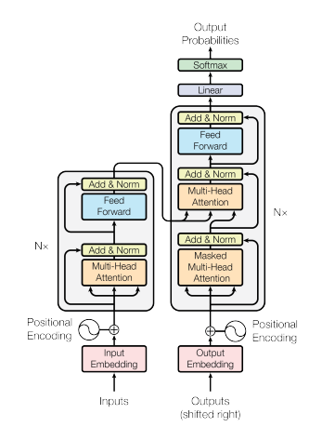
Why using Transformers?
Analysing language for translation, text generation and summarisation
RNN is a sequential model,
  Struggle to capture and retain relevant information from earlier parts of the sequence.
  Hard to train
Model developed by researchers at Google with University of Toronto in 2017
  Introduced attention mechanisms
  Allow parallel processing
  Better handling of long-range dependencies.

Slide 6
Dataset -Glassdoor
Real-world Employee Review
Comprehensive Information
Records: 838566
18 features
Diversity and Volume
428 unique UK Companies; Citi, Tesco, Barclays’ etc.

Slide 7
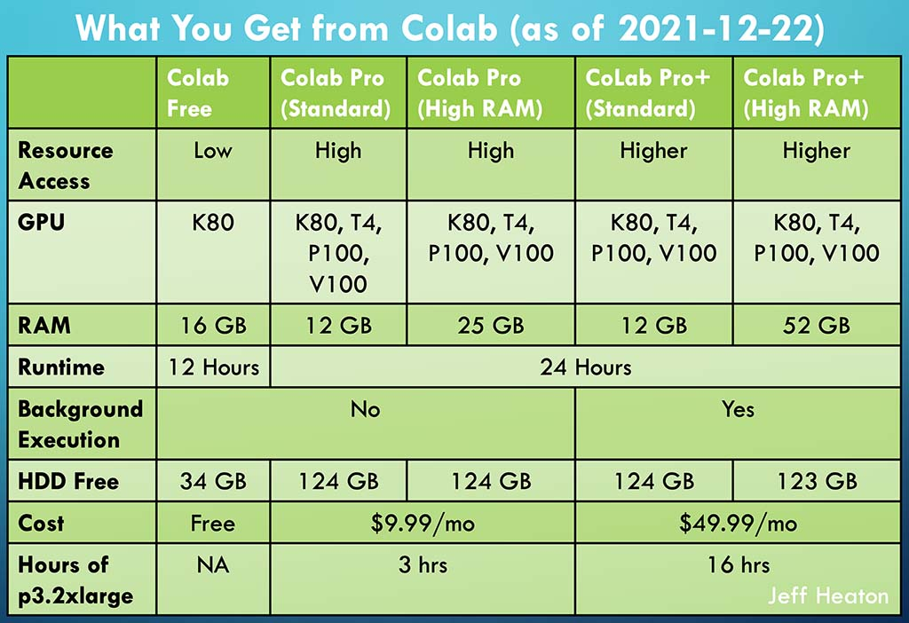


Tools and softwares

Slide 8



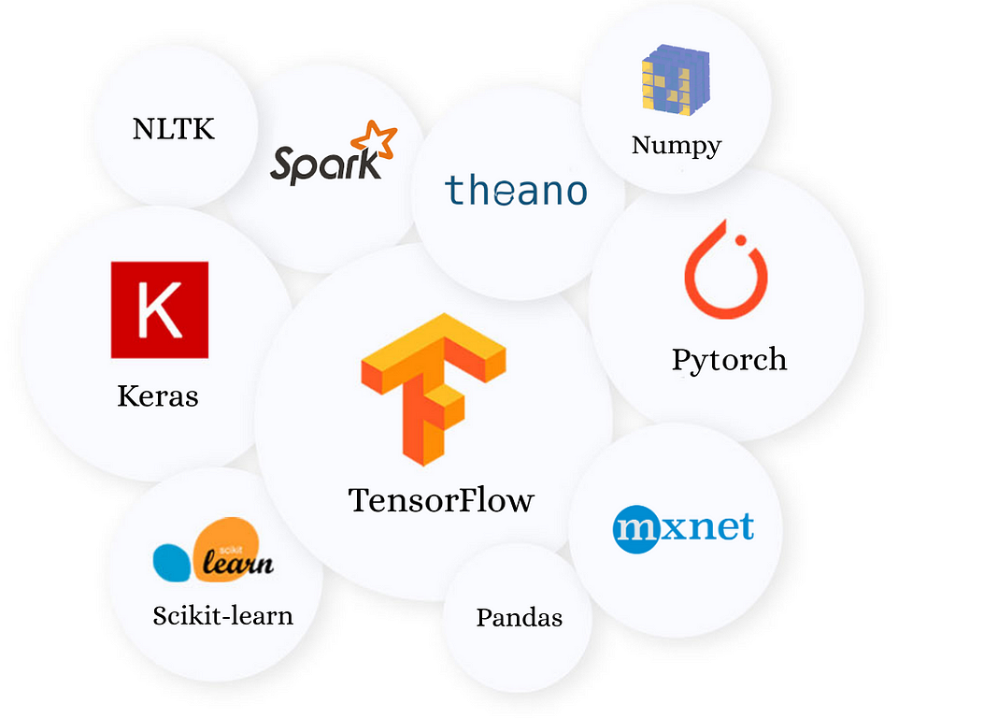
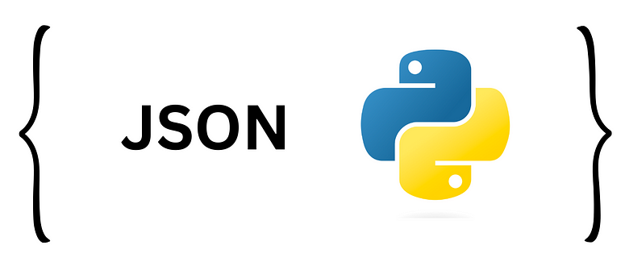


Python libraries
Data Manipulation and Visualization:
Numpy
Pandas Matplotlib
Seaborn
Time
JSON
Natural Language Processing (NLP):
Spacy
NLTK
GENSIM

Slide 9
Python libraries
Machine Learning and Deep Learning:
Scikit-learn (sklearn)
Transformers
Torch
Sentiment Analysis and Text Processing:
VaderSentiment
Wordcloud

Slide 10
Transformer model Development & Training
Language Model | Accuracy | Precision | Recall | F1-score
DistilBERT | 76% | 0.75 | 0.94 | 0.83
BERT | 75% | 0.79 | 0.83 | 0.81
RoBERTa | 77% | 0.79 | 0.88 | 0.83
DeBERTa | 72% | 0.71 | 0.94 | 0.81
XLNet | 75% | 0.78 | 0.86 | 0.81

Slide 11
Transformer model Development & Training
Language Model | Accuracy | Precision | Recall | F1-score
DistilBERT | 74% | 0.77 | 0.83 | 0.80
BERT | 75% | 0.78 | 0.84 | 0.81
RoBERTa | 76% | 0.77 | 0.88 | 0.82
DeBERTa | 75% | 0.75 | 0.90 | 0.82
XLNet | 76% | 0.75 | 0.91 | 0.83

Slide 12
Stakeholders and Benefits
Companies and Businesses
Gain valuable insights into customer opinions, sentiments, and preferences
Reduce employee churn
Help in product/service improvements, marketing strategies, and overall employee satisfaction
Researchers and Developers
Provides a practical application of transformer-based models.
Investors and Decision Makers
Helps them choose smarter investments using lots of employee data.
Online Review Platforms
Platforms hosting reviews, like Glassdoor or similar websites, might benefit from improved sentiment analysis tools.

Slide 13
Reflection
Objectives Achieved:
Sentiment Analysis: Accurately classified sentiments using transformer-based models.
Topic Modelling & Comparative Analysis: Unearthed prevalent themes and emerging trends in company reviews.
Aspect-Based Sentiment Analysis: Identified specific aspects influencing sentiments.
Learnings & Future Prospects:
Holistic Insights: Comprehensive understanding of customer experiences and company strengths.
Strategic Decision-Making: Enhanced planning for product, service improvements, and talent acquisition.
Continual Improvement: Ongoing refinement of analysis for evolving insights and industry trends.
Impact & Contribution:
Job Seekers: Informed decisions about potential employers.
Companies: Strategic improvements and planning.
Glassdoor: Enhanced insights into company reviews.

Slide 14
Demonstration…
Web Prototype
http://project-uog.s3-website.eu-north-1.amazonaws.com
Notes:
Used languages and tool.

